Slide 1
Missing Word Predicition For Long Sentence
Canyu Zhang

Slide 2
Goal
Predict the missing words in long sentences.

Slide 3
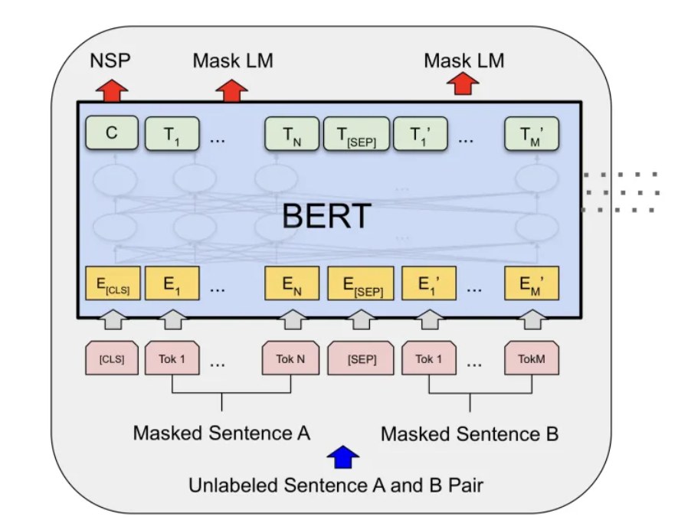
Model
BERT -- a multi-layer bidirectional Transformer encoder
Its composed of several transforemr encoders.

Slide 4
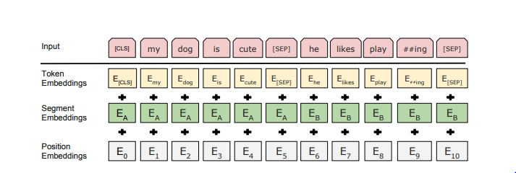
Input

Slide 5
Datasets
Generated around 100 long sentences.
Using generated dataset to fine-tune pre-trained model for 150 epoch.

Slide 6
Results
L1 score: reprsenting the similarity between predicted words and the ground truth.
10%
L1:

Slide 7
Example
The First World War _ with the Armistice of 11 November 1918, although it was not officially _ over until the signing of the Treaty of Versailles on 28 June 1919. The British _ planned to hold a victory _ in London on 19 July, including soldiers _ to Whitehall, the centre of the _ government.The _ design for what would become the Cenotaph was one of a number of temporary structures erected along the parade's _.
Pred: ended declared government parade marching British original route
GT: ended declared government parade marching British initial route

Slide 8
Lutyens _ his final design to the _ of Works in early July, and on 7 July received confirmation that the _ had been approved by the foreign secretary, Lord Curzon, who was organising the parade. The unveiling of the monument, _ in wood and plaster by the Office of Works, was _ in The Times as a quiet and unofficial ceremony. It _ place on 18 July 1919, the day _ the Victory Parade.Lutyens was not _. During the parade, 15,000 soldiers and 1,500 officers marched past and _ the Cenotaph.
GT: submitted Office confirmation design built described took before invited saluted
Pred: submitted Office confirmation design painted described took of present around

